Slide 1
A Stairs Versus Lifts Detector
Ubiquitous Systems Lab Project
Members Name: | Number:
Ravikiran Arasur | 1702835
Sai Vijji Raju Saripella | 1650783
Joseph Ntibi | 1609794

Slide 2
Idea:
We are going to build a device which will consist of sensor namely MPU6250 connected to Pico
MPU6250 is a sensor to measure acceleration across the 3 co-ordinates and it has four functions namely, gyrometer, thermometer, accelerometer and magnetometer. This is also connected to Pico via I2C.
I2C is simple communication protocol used to establish communication between multiple peripheral devices and one / more controller device.
We are using ESP32 to use the Bluetooth functionality.
ESP32 will be connected to Espruino Pico via Serial connection and Bluetooth from this ESP32 will be used in the Data Transmission.
A Smart phone App has been built for this functionality alone using MIT App inventor.

Slide 3
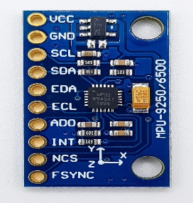
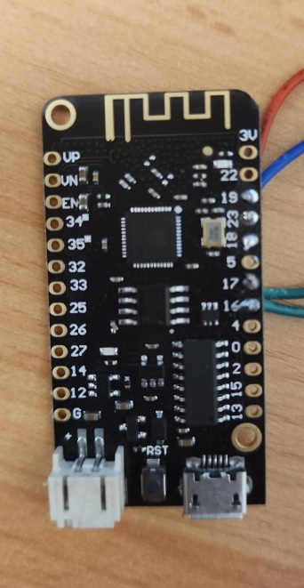
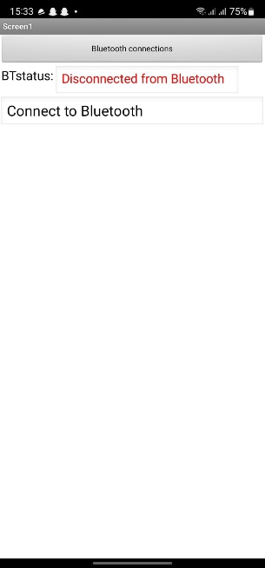

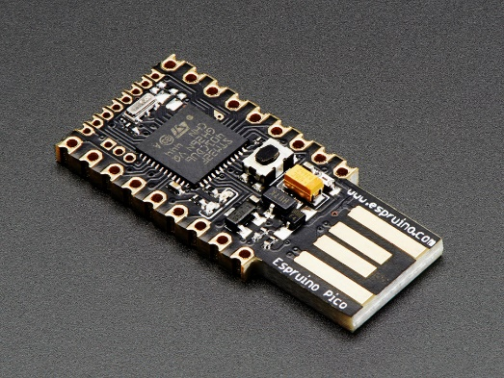
Design
MPU 6250
ESP32
Smart Phone App
I2C
Serial
Espruino Pico

Slide 4
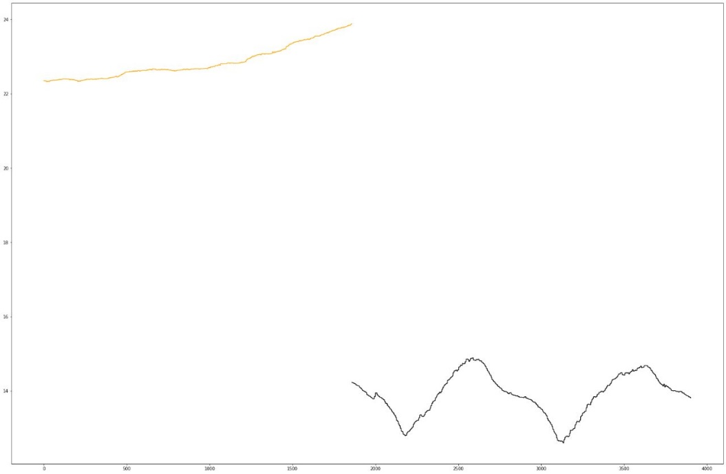
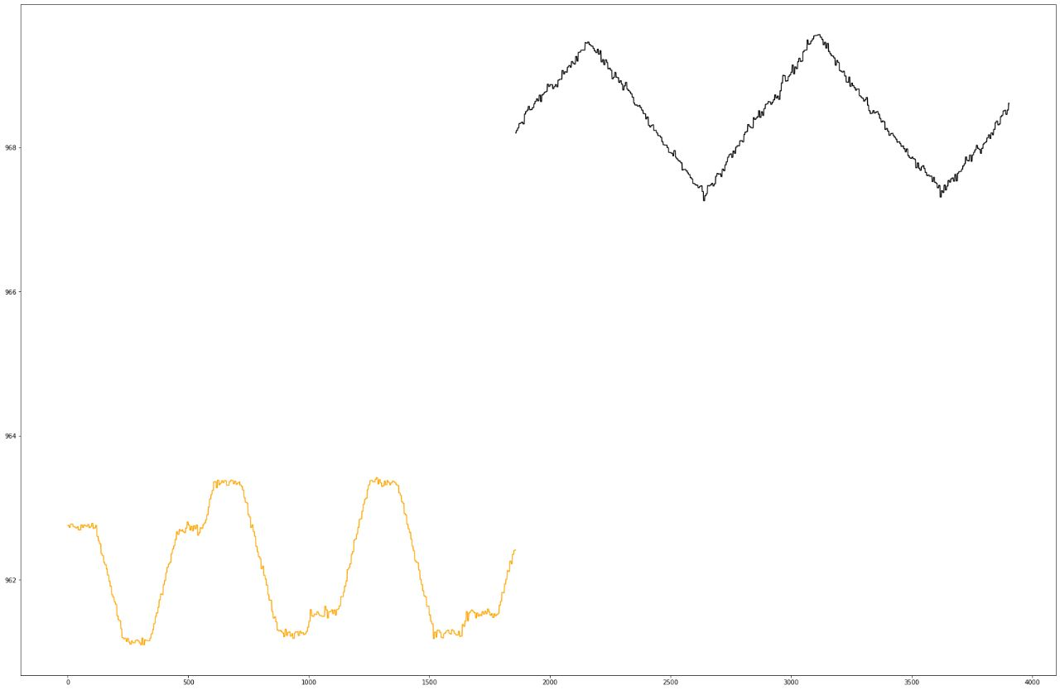
Implementation
We collected Data from two Sensors BME280 and MPU6250. Temperature and Pressure from BME280 Sensor and Acceleration Data from MPU6250
Temperature vs Time
Pressure vs Time
Stairs
Lift

Slide 5
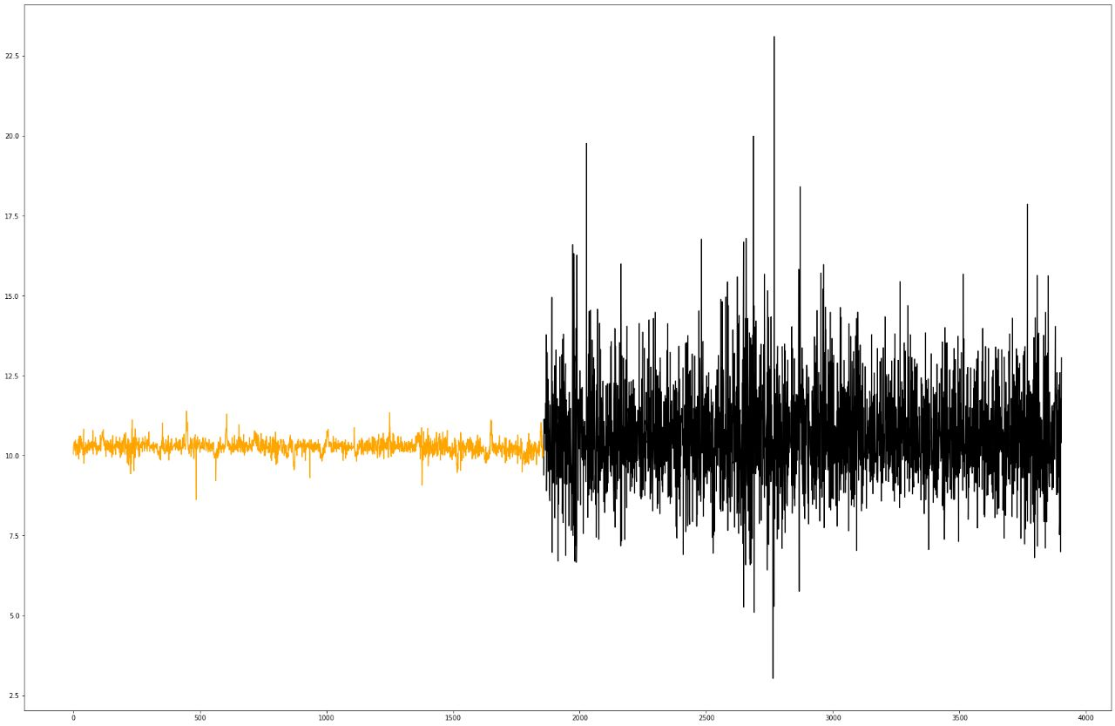
Implementation
We collected Data from two Sensors BME280 and MPU6250. Temperature and Pressure from BME280 Sensor and Acceleration Data from MPU6250
Acceleration vs Time
Stairs
Lift

Slide 6
Implementation
We sample the Acceleration Data from MPU6250 Sensor at 5Hz.
We keep collecting the Acceleration Data to analyse and calculate the Result in Real time.
We calculate the average Acceleration for every 4 sec and calculate the Deviation of each Acceleration data point from the average Acceleration.
We compare the Deviation and the number of the values with Threshold Deviation and Threshold count, then We determine whether an Individual is taking Lifts or Stairs.
This Result will be calculated for every 4sec, But only sent to the Smart phone on users request.

Slide 7
Implementation
Result class | class=0 “not_moving” | class=1 “lifts” | class=2 “stairs” | class=3 “not sure”
Deviation condition | deviation <= 0.2 | deviation <0.4 | deviation>=0.4 | ~
Count | stnading_count >= 19 | lift_count>=12 | stair_count>=12 | stairs_count <12 lift_count < 12
Deviation = Abs(average acceleration - each acceleration datapoint)
count = number of values that satisfy the deviation condition

Slide 8
Implementation
ESP32 has been employed for the Bluetooth communication.
ESP32 will be connected to Espruino Pico via Serial pins (RX and TX).
ESP32 will create a Bluetooth server which is used by Smart phone Application to exchange the Data.
When it receives request from the user (Smartphone), It will pass this signal to the Espruino Pico.
Espruino Pico will return the Result to ESP32 which in turn transfers Data to the user on the Smartphone App.

Slide 9
Implementation
Smartphone App has been built using MIT App Inventor.
It is designed to be user Friendly.
It is simple and can be used by anyone without any prior knowledge.
It has a Bluetoothclient Module which will be used to connect to the ESP32.
Once the Connection is established, Users will be able to request the Data.
Once user clicks on Detect button, 1 Byte number will be sent to ESP32 as a Signal.
Based on the result we get back from the ESP32, The App displays proper message and Image to the User.
The following slides contain pictures from the Smartphone app.

Slide 10
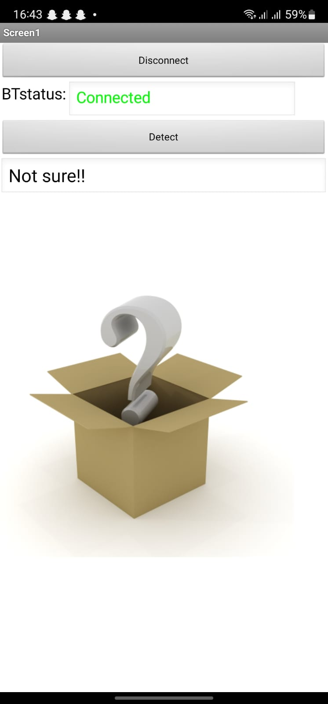
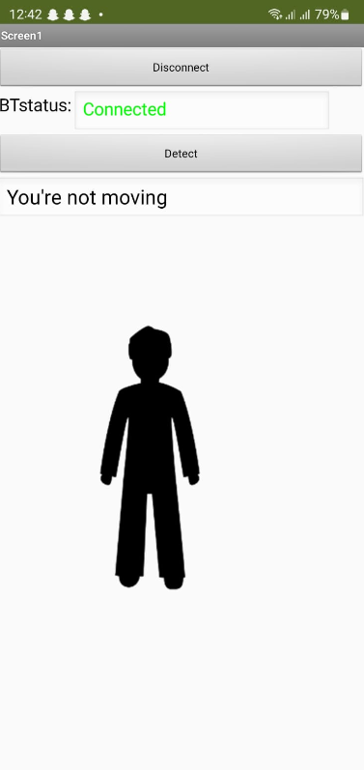
Results

Slide 11
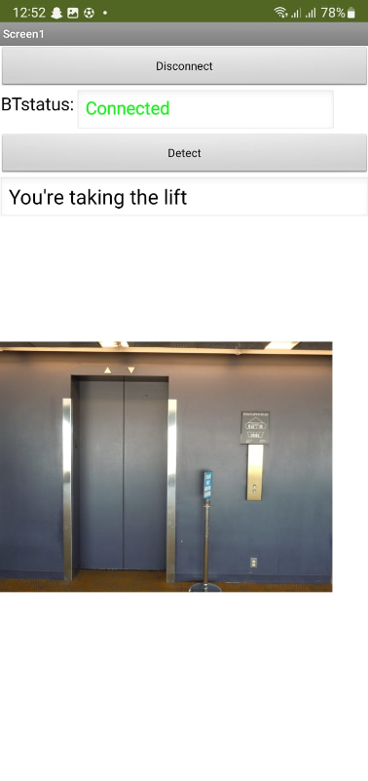
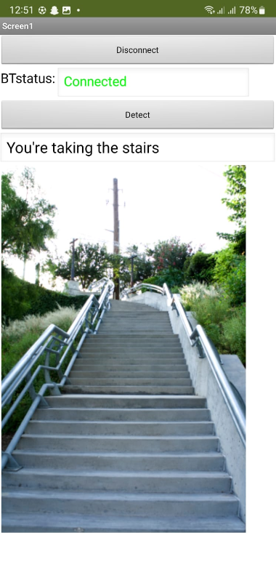
Results

Slide 12
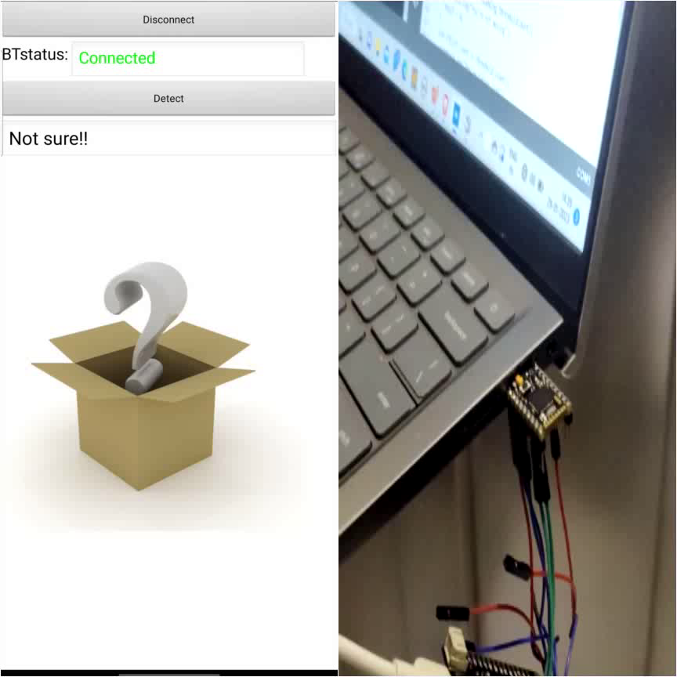
Result

Slide 13
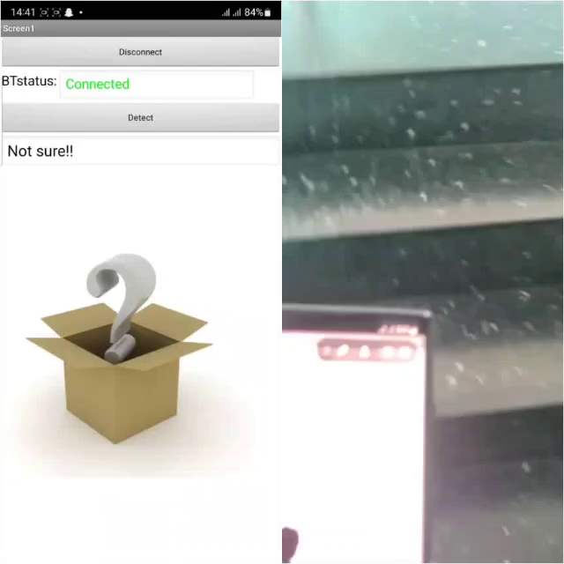
Result

Slide 14
Thank You
Any Questions??

